Slide 1

MUNA INVESTMENTS GROUP
MUNA

Slide 2
SCOPE AHEAD
App Description
Reviewing the Code
Objectives
Demo
Initial Design

Slide 3
APP DESCRIPTION
Stock API – cloud.iexapis.com, Alphavantage
FAANG stocks
User input: Enter stock symbols, What if
Scrolling news in the header
Cards with company name, ticker symbols, chart
Logo & our company name

Slide 4

OBJECTIVES
Enhanced JavaScript Knowledge through hands on exercises
Use JavaScript knowledge and principles learned through TLG
Creating a Stock tracking app

Slide 5
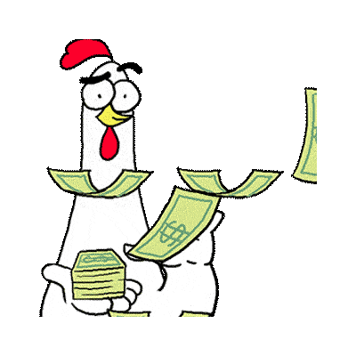
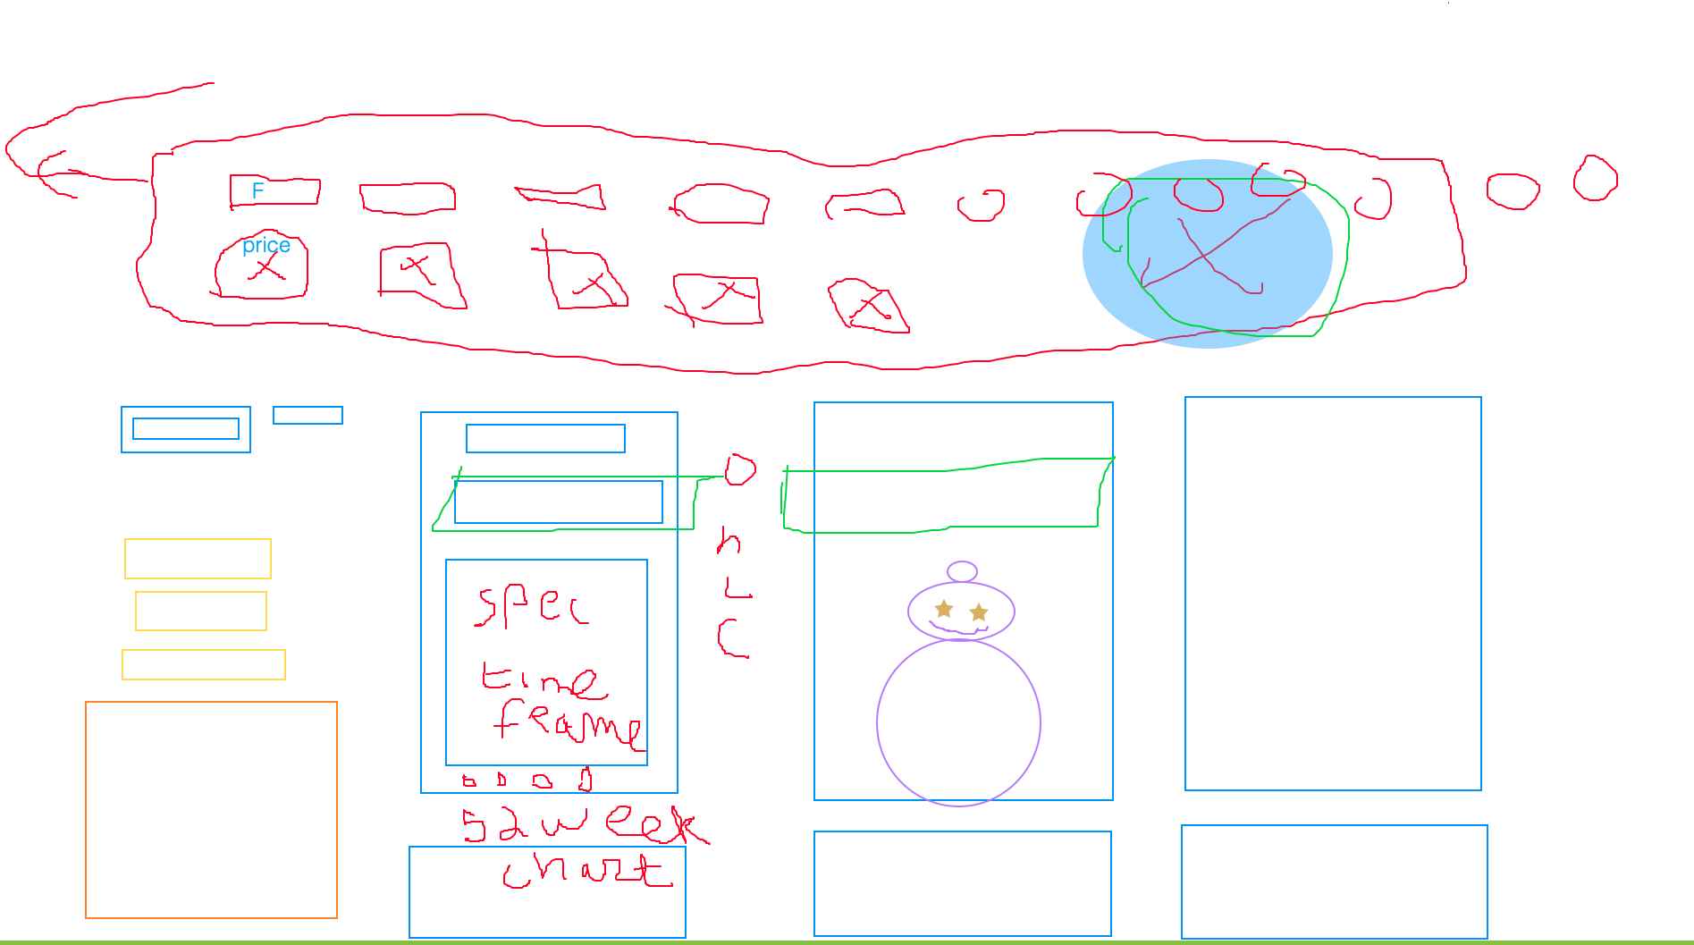
INITIAL DRAFT
.​

Slide 6
LESSON LEARNED
Getting a full picture of what coding is.​
Patience, pair programming, explaining as you go.​
Finding strengths in each other and capitalizing on them.​

Slide 7
OUR LOGO

Slide 8

QUESTIONS
​

